Slide 1
Business Strategy & Consulting Template Pack
Sample Slides

Slide 2
About the template pack
Section 1

Slide 3




The template pack enables professionals to build high-quality presentations for senior executives in less time
Earn visibility and recognition from senior executives
Clear, well-structured slides make your thinking visible at the senior level. When executives quickly grasp your point, your work gets recognized, trusted, and rewarded.
Save hours of time and build high-quality slides
faster
Start from proven layouts instead of rebuilding decks from scratch. These templates give you a fast, repeatable way to turn your thinking into presentation-ready slides.
Guarantee your slides are executive-level and consulting-grade
Our templates are designed to reflect the level of clarity and rigour expected in executive and consulting environments. Your slides will feel structured, and credible.
Apply best practice storylining, layouts, and visualizations
By working from proven structures, you are able to write better storylines, apply best-practice layouts, and visualize your data in the most impactful way for executives.

Slide 4
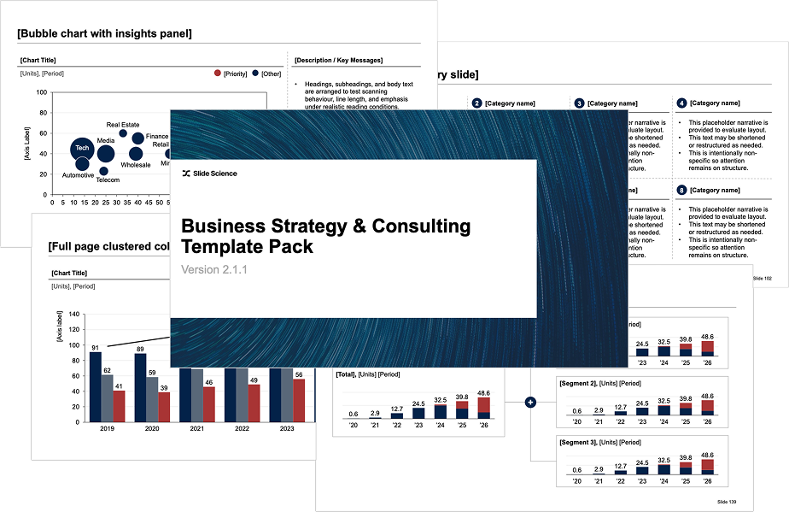
You’ll find a slide for every situation, no matter what type of presentation you’re building
16+
business topics and categories
250+
executive-ready slide templates
1500+
unique business icons
>
500+
unique icons, flags and maps
25+
consulting frameworks

Slide 5
The template pack has already helped countless corporate professionals get visibility and recognition from senior leaders
★★★★★
“Highly recommended investment if you are in a role where you need to influence senior level decision makers.”
James Gowen Jr
★★★★★
“It's by far and away the best slide template pack on the market today. The slide pack covers end to end ready made decks for any scenario.”
Jillian Jooste
100%
★★★★★
“Saves time and is well worth the cost.”
Mo Ali
★★★★★
“This slide pack makes it so much easier to create polished, executive-ready presentations in less time.”
Jia Xie
★★★★★
“You will not be disappointed.”
James McLean
of customers would recommend this
template pack to a friend¹
★★★★★
“The template pack makes it easy to get inspired for your slide deck and create convincing presentations.”
Kyle Toole
★★★★★
“Life-changing […] slide template pack for executive presentations!”
Sarah Doherty
Notes: (1) Based on a survey of customers who reviewed a pre-release version of this template pack

Slide 6
Example slides
Section 2

Slide 7
[Stacked column chart with insights panel]
[Chart Title]
[Description / Key Messages]
[Units], [Period]
[Series]
[Series]
[Series]
Headings, subheadings, and body text are arranged to test scanning behaviour, line length, and emphasis under realistic reading conditions.
Paragraph breaks indicate logical transitions without implying causal relationships or substantive conclusions.
This text may be repeated, shortened, or restructured as needed to assess consistency across slides, pages, or components.
This text may be repeated, shortened, or restructured as needed to assess consistency across slides.
[Axis Label]
194
187
211
222
246
271
292
333
2018
2019
2020
2021
2022
2023
2024
2025

Slide 8
[Clustered row chart with insights panel]
[Chart Title]
[Description / Key Messages]
[Units], [Period]
Headings, subheadings, and body text are arranged to test scanning behaviour, line length, and emphasis under realistic reading conditions.
Paragraph breaks indicate logical transitions without implying causal relationships or substantive conclusions.
This text may be repeated, shortened, or restructured as needed to assess consistency across slides, pages, or components.
This text may be repeated, shortened, or restructured as needed to assess consistency across slides.
[Overperforming markets]
Mining
TMT
Retail
[Baseline
markets]
FMCG
Finance
Real Estate
Industrials
Telecom
Healthcare
[Underperforming markets]
Energy
Utilities
Media

Slide 9
[Full page row chart with categories]
[Chart Title]
[Units], [Period]
[Abandoned]
This text may be repeated, shortened, or restructured as needed to assess consistency across slides.
[Failed or Partially Failed]
This text may be repeated, shortened, or restructured as needed to assess consistency across slides.
[Call out title]
This placeholder narrative is provided solely to evaluate the layout.
[Successful]
This text may be repeated, shortened, or restructured as needed to assess consistency across slides.

Slide 10
[Full page 100% Marimekko chart]
[Chart Title]
[Units], [Period]
$1.6t
$1.1t
$1.1t
$1.0t
$0.9t
$0.8t
$0.8t
$0.7t
$0.6t
$0.5t
$0.5t
$0.4t
Emerging
14%
12%
9%
9%
9%
9%
9%
12%
8%
7%
10%
7%
32%
34%
33%
37%
30%
31%
30%
29%
31%
Growth
38%
35%
32%
53%
59%
57%
58%
55%
61%
55%
61%
63%
60%
62%
Core
49%
TMT
Industrials
Mining
Finance
FMCG
Healthcare
Real
Estate
Energy
Auto.
Retail
Telecom
Logistics
Utilities
Media
Airlines
[X] largest industries make up [Y]% of the total market

Slide 11
[Full page scatterplot with groups]
[Chart Title]
[Units], [Period]
⬤ [Group A]
This placeholder narrative is provided solely to evaluate the layout.
⬤ [Group B]
This placeholder narrative is provided solely to evaluate the layout.
⬤ [Group C]
This placeholder narrative is provided solely to evaluate the layout.
[Axis Label]
[Axis Label]

Slide 12
[Full page “gap-to-target” waterfall chart]
[Chart Title]
[Units], [Period]
[Supply Gap]
This placeholder narrative is provided solely to evaluate the layout.
5k
[Affordable homes]
[Unsuitable homes]
[Total supply]
[Supply gap]
[Renters]
[Owners]
[Investors]
[Total demand]
[Supply / Housing Stock]
This placeholder narrative is provided solely to evaluate the layout.
[Demand / Households]
This placeholder narrative is provided solely to evaluate the layout.

Slide 13





[Key metrics column slide]
[Category 1]
[Category 2]
[Category 3]
[Category 4]
[Category 5]
$50B
The content is non-specific so attention remains on structure
$50B
The content is non-specific so attention remains on structure
$50B
The content is non-specific so attention remains on structure
$50B
The content is non-specific so attention remains on structure
$50B
The content is non-specific so attention remains on structure
45%
The content is non-specific so attention remains on structure
45%
The content is non-specific so attention remains on structure
45%
The content is non-specific so attention remains on structure
45%
The content is non-specific so attention remains on structure
45%
The content is non-specific so attention remains on structure

Slide 14
[Comparison table – Mixed text and charts]
[Competitor]
[Strategic Positioning]
[Financials], [Unit] [Year]
[Mkt Share], [Unit] [Year]
[Competitor Logo]
This placeholder narrative is provided solely to evaluate layout. This text may be shortened or restructured as needed.
18%
[Competitor Logo]
This placeholder narrative is provided solely to evaluate layout. This text may be shortened or restructured as needed.
16%
[Competitor Logo]
This placeholder narrative is provided solely to evaluate layout. This text may be shortened or restructured as needed.
13%
[Competitor Logo]
This placeholder narrative is provided solely to evaluate layout. This text may be shortened or restructured as needed.
8%
[Competitor Logo]
This placeholder narrative is provided solely to evaluate layout. This text may be shortened or restructured as needed.
$20m Revenue
4%
$4m Profit

Slide 15
[Comparison matrix with combined categories and insight panel]
[Chart Title]
[Description / Key Messages]
[Units], [Period]
Headings, subheadings, and body text are arranged to test scanning behaviour, line length, and emphasis under realistic reading conditions.
Paragraph breaks indicate logical transitions without implying causal relationships or substantive conclusions.
This text may be repeated, shortened, or restructured as needed to assess consistency across slides, pages, or components.
This text may be repeated, shortened, or restructured as needed to assess consistency across slides.
[Item name]
[Dimension]
[Item name]
[Leaders]
[Item name]
[Item name]
[Item name]
[Contenders]
[Item name]
[Item name]
[Dimension]
[Item name]
[Challengers]
[Dimension]
[Dimension]

Slide 16
[Three stage slide with categories]
Stage 1: [Name of stage]
Stage 2: [Name of stage]
Stage 3: [Name of stage]
[Category or section title]
[Name of initiative]
[This text may be repeated or restructured as needed.]
[Name of initiative]
[This text may be repeated or restructured as needed.]
[Name of initiative]
[This text may be repeated or restructured as needed.]
[Category or section title]
[Name of initiative]
[This text may be repeated or restructured as needed.]
[Name of initiative]
[This text may be repeated or restructured as needed.]
[Name of initiative]
[This text may be repeated or restructured as needed.]
[Category or section title]
[Name of initiative]
[This text may be repeated or restructured as needed.]
[Name of initiative]
[This text may be repeated or restructured as needed.]
[Name of initiative]
[This text may be repeated or restructured as needed.]

Slide 17
[Findings slide – Combination summary and verbatims]
[Summary of Finding]
[Verbatims]
[Finding]
This placeholder narrative is provided solely to evaluate layout balance.
[This should contain a direct quote from a primary source]
[This should contain a direct quote from a primary source]
>
[Finding]
This placeholder narrative is provided solely to evaluate layout balance.
[This should contain a direct quote from a primary source]
[This should contain a direct quote from a primary source]
>
[Finding]
This placeholder narrative is provided solely to evaluate layout balance.
[This should contain a direct quote from a primary source]
[This should contain a direct quote from a primary source]
>
[Finding]
This placeholder narrative is provided solely to evaluate layout balance.
[This should contain a direct quote from a primary source]
[This should contain a direct quote from a primary source]
>
[Finding]
This placeholder narrative is provided solely to evaluate layout balance.
[This should contain a direct quote from a primary source]
[This should contain a direct quote from a primary source]
>

Slide 18
[Project workstreams slide]
[Workstream]
[Describe a goal of the workstream here]
[Describe a goal of the workstream here]
[Describe a goal of the workstream here]
[Stream Lead]
[Name here]
Project Goal
[Describe the overall goal of the project here]
[Workstream]
[Describe a goal of the workstream here]
[Describe a goal of the workstream here]
[Describe a goal of the workstream here]
[Stream Lead]
[Name here]
[Workstream]
[Describe a goal of the workstream here]
[Describe a goal of the workstream here]
[Describe a goal of the workstream here]
[Stream Lead]
[Name here]

Slide 19
[Project plan – Detailed version]
Timeline (Weeks)
1
2
3
4
5
6
7
8
9
10
11
12
13
14
15
16
17
18
19
20
21
Activities
[Activity label]
[Activity label]
[Activity label]
[Activity label]
[Activity label]
[Activity label]
[Activity label]
[Activity label]
[Activity sub-label]
[Activity label]
[Activity label]
[Activity label]
[Activity label]
[Activity label]
Milestones
[Milestone label]
[Milestone label]
[Milestone label]

Slide 20
How to purchase the full template pack
The full template pack can be purchased from the Slide Science website:
https://slidescience.co/product/slide-templates/overview/
As part of your purchase, you will get all slides and materials, video tutorials, and lifetime access to all future updates:
16+ business and strategy topics
250+ consulting-quality slides
1,500+ unique business icons
500+ maps and flags
25+ strategy and consulting frameworks
Video tutorials on how to use the template pack
Lifetime access and all future updates
If you have any questions, just email me at dan@slidescience.co

Slide 21
License & Terms of Use
These slide templates are licensed, not sold. You may use and modify the templates for personal and commercial work, including client presentations, reports, proposals, and internal documents.
You may not resell, redistribute, sublicense, share, or make the templates available to others in any form — including modified versions. The templates may not be included in another product, course, training, video, or template pack (free or paid), nor used to create competing slide, presentation, or training products.
All templates remain the intellectual property of Slide Science Pty Ltd. This licence is granted to a single user only. All rights not expressly granted are reserved.

